Slide 1

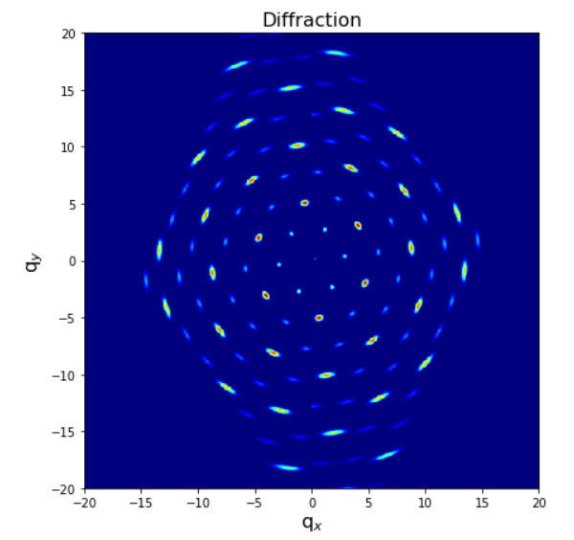
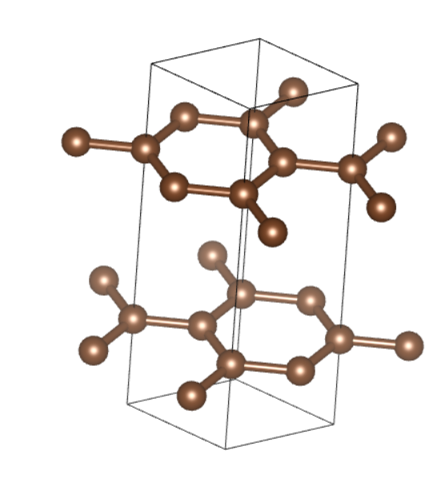
2D perovskite diffraction pattern simulation
Zihan Zhang

Slide 2
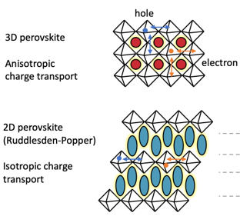
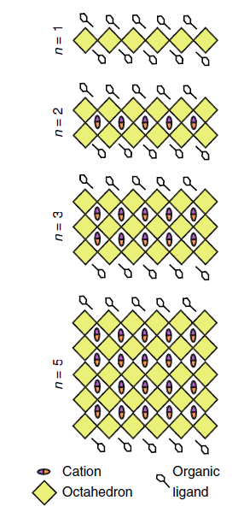
Ruddlesden-Popper phase
A_{n+1}B_{n}X_{3n+1} or R₂A_{n-1}B_{n}X_{3n+1}
Self-assembled 2D material
Enhanced moisture stability
Anisotropic charge transport (Quantum well)
High exciton binding energy
Promising material for light-emitting diodes, spin valves, and field-effect transistors
isotropic
anisotropic

Slide 3
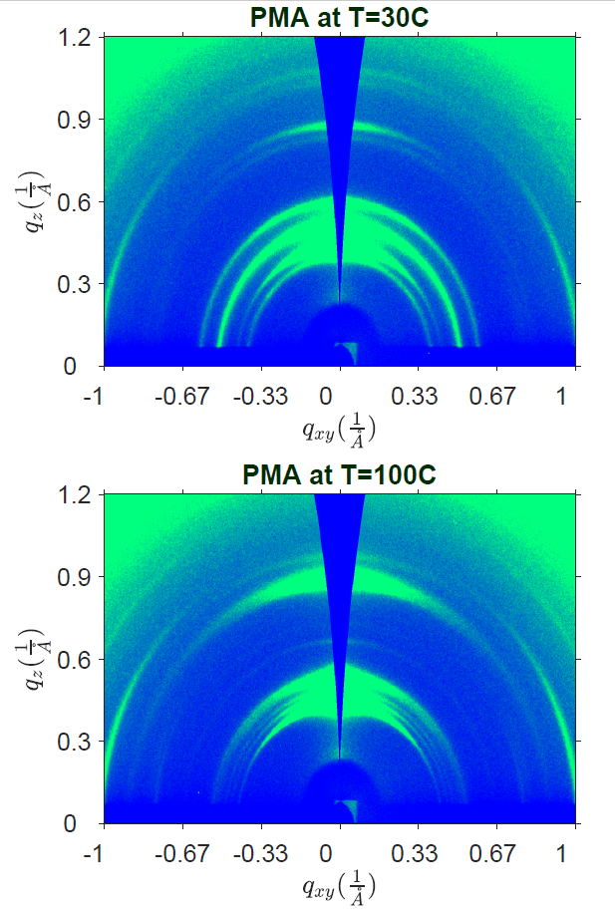
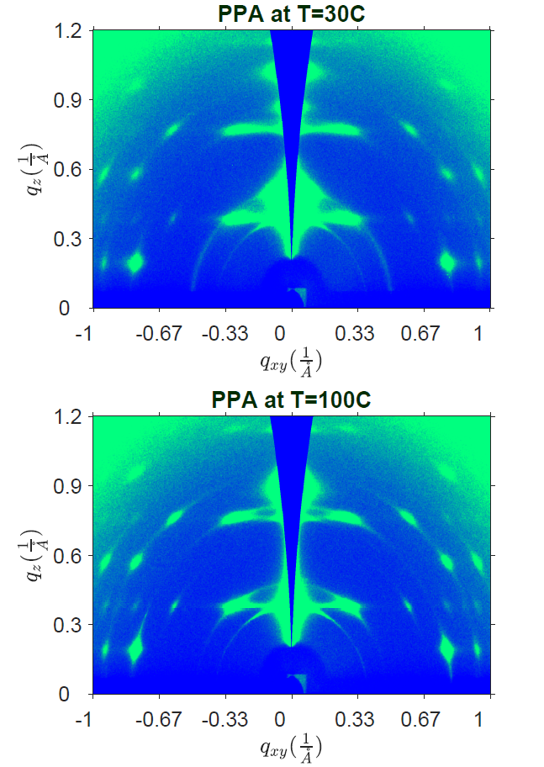
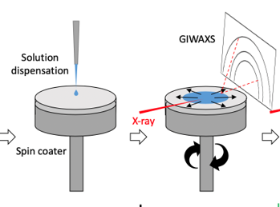
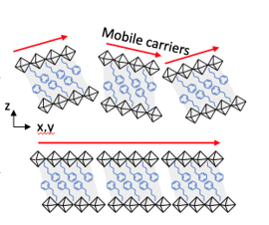
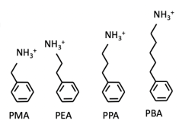
Orientation:
(PPA)₂PbI₄
(PMA)₂PbI₄
Spin coating:

Slide 4
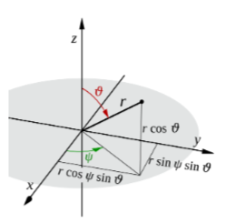
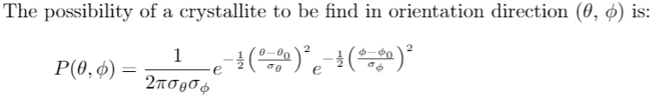
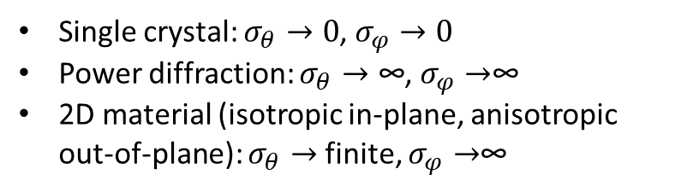
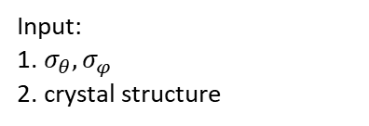
Python Program for GIWAXS simulation:
Gaussian distribution model:
Single crystal: $σ_{θ}→0$, $σ_{φ}→0$
Power diffraction: $σ_{θ}→\text{∞}$, $σ_{φ}→$∞
2D material (isotropic in-plane, anisotropic out-of-plane): $σ_{θ}→$ finite, $σ_{φ}→$∞
(PMA)₂PbI₄
Input:
1. $σ_{θ},σ_{φ}$
2. crystal structure
output:
Diffraction pattern
in q_{z} ,q_{xy}
Program
https://github.com/ZihanZhang-1996/2D_diffraction
Python & matlab

Slide 5
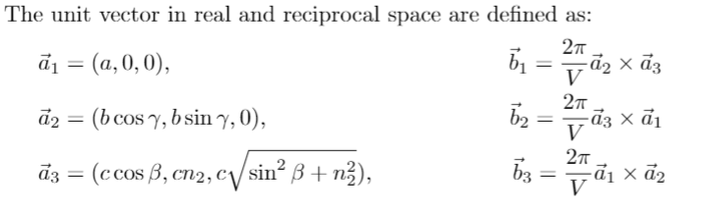
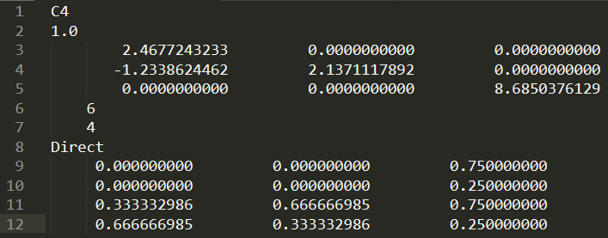
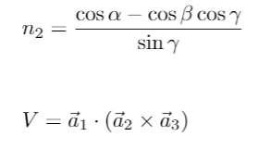
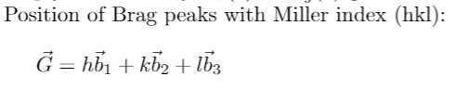
Algorithm:
1. Bragg peaks
Read crystal structure from POSCAR file
where
POSCAR ↔ CIF
By VESTA VASP …

Slide 6
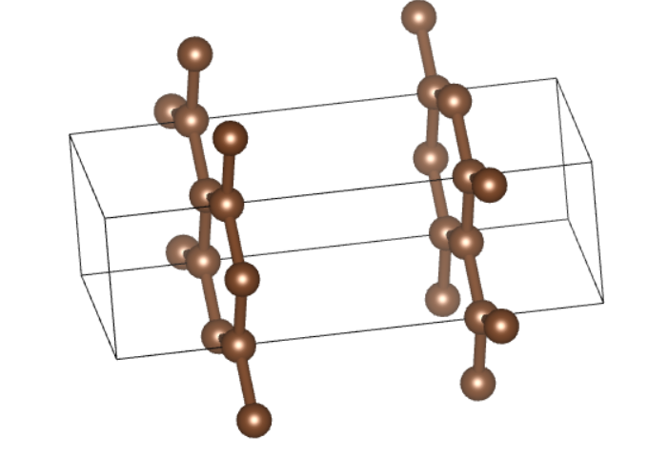
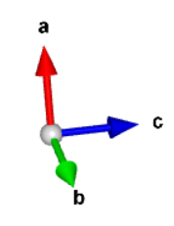
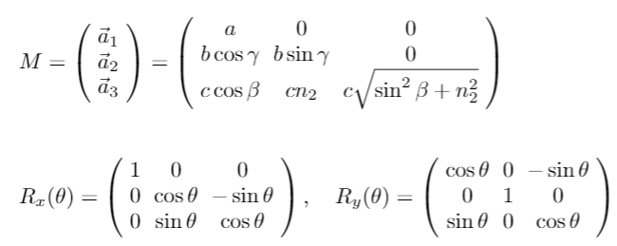
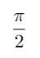
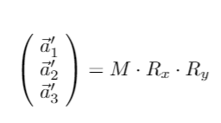
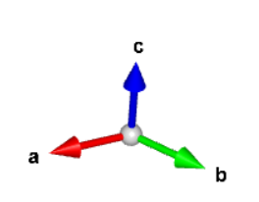
Algorithm:
1. Bragg peaks
Rotation Matrix
z
c
x
y
c
Rotate around y axis
z
c
y
c
c
x

Slide 7
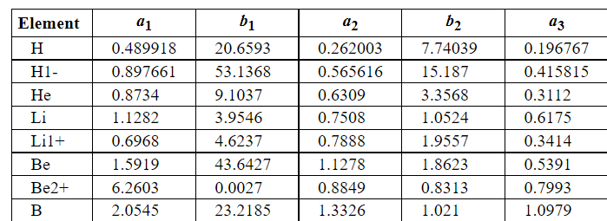
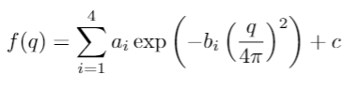
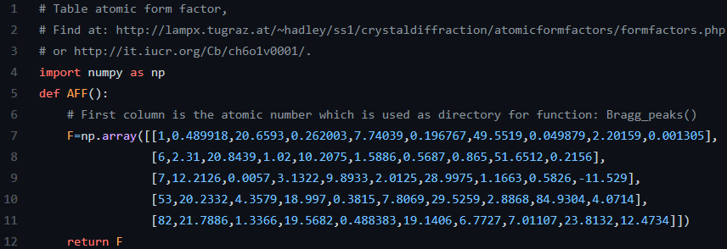
Algorithm:
1. Bragg peaks
Atomic Form Factor
AFF.py

Slide 8
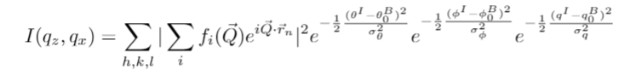
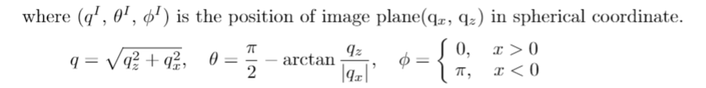
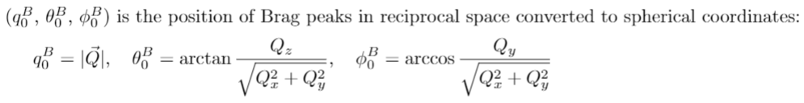
Algorithm:
Calculate the intensity:

Slide 9
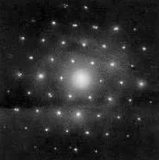
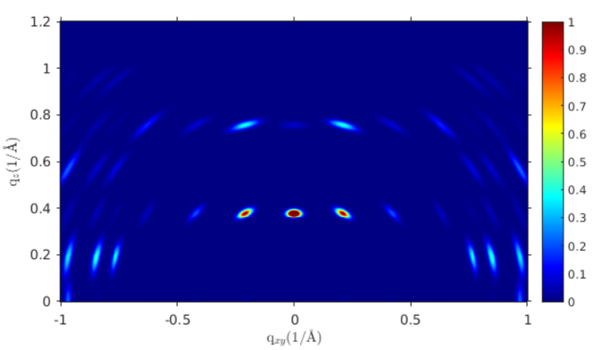
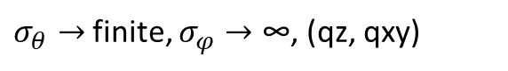
2D perovskite GIWAXS
Examples:
Graphite single crystal:
$σ_{θ}→0$, $σ_{φ}→0$, in-plane(qx, qy)
Experiment:
$σ_{θ}→$finite, $σ_{φ}→\text{∞}$, (qz, qxy)

Slide 10
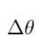
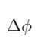
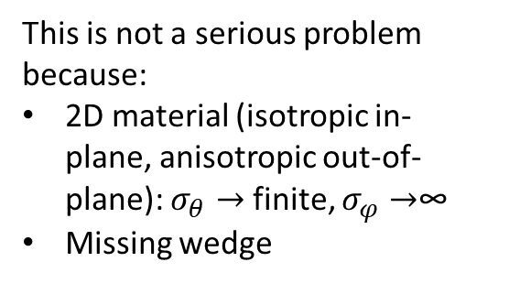
The model is not well-defined near qz:
and
is not independent at qxy=0.
This is not a serious problem because:
2D material (isotropic in-plane, anisotropic out-of-plane): $σ_{θ}→$ finite, $σ_{φ}→$∞
Missing wedge

Slide 11
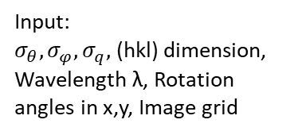
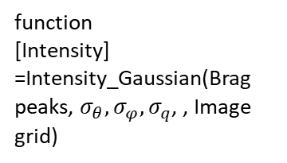
Input:
$σ_{θ},σ_{φ},σ_{q},$ (hkl) dimension,
Wavelength λ, Rotation angles in x,y, Image grid
Runtime:
image = 500 x 500 pixels
(hkl) = from -5 to 5
< 1min on PC
function
[Intensity]
=Intensity_Gaussian(Brag peaks, $σ_{θ},σ_{φ},σ_{q}$, , Image grid)
function
[lattice constants, atom positions]
= Read(POSCAR)
function
[Intensity]
=Lorentz_polarization_correction(Intensity, wavelength)
function
[Brag peaks]
= rcpeaks(crystal structure, (hkl) dimension, Rotation)
(qz,qxy) plane Image display
https://github.com/ZihanZhang-1996/2D_diffraction

Slide 12
